Slide 1

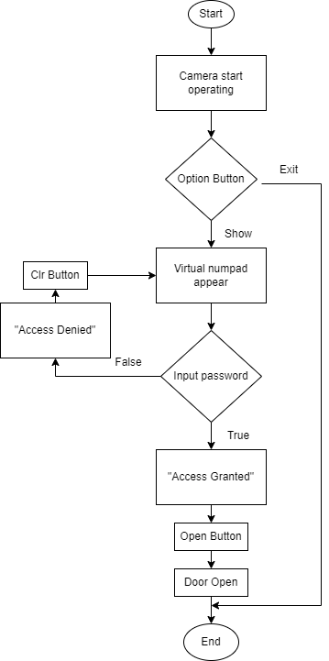

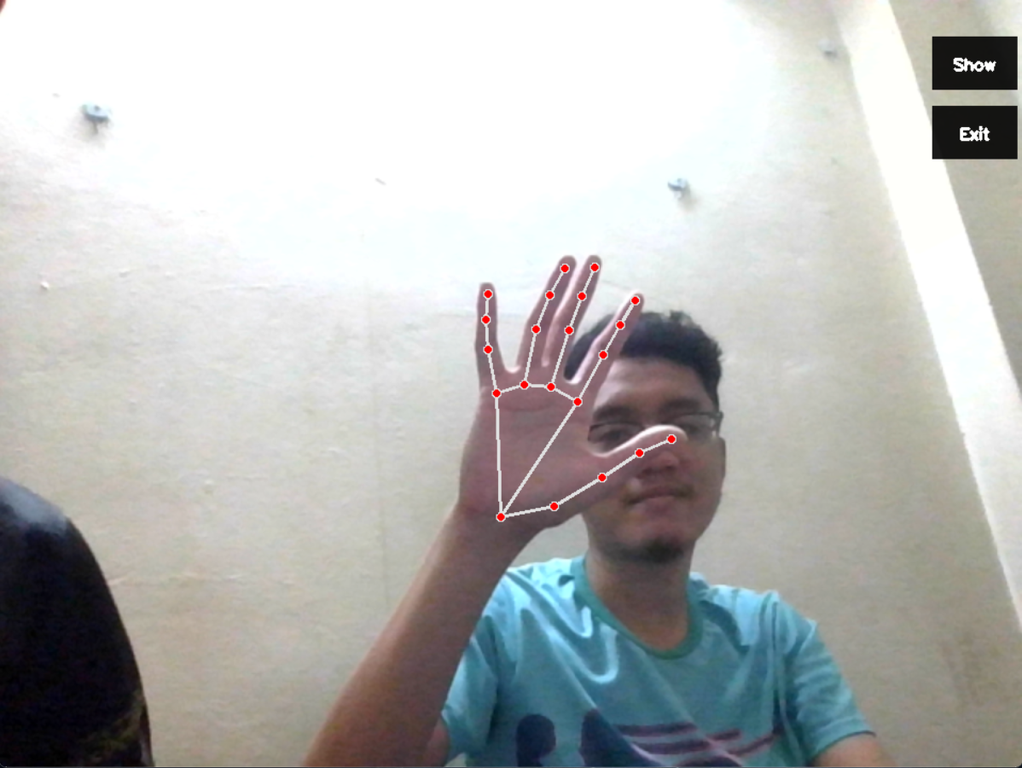
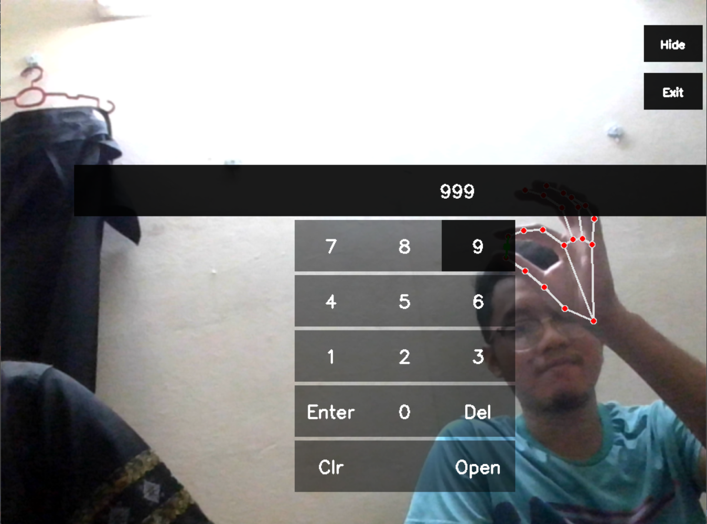
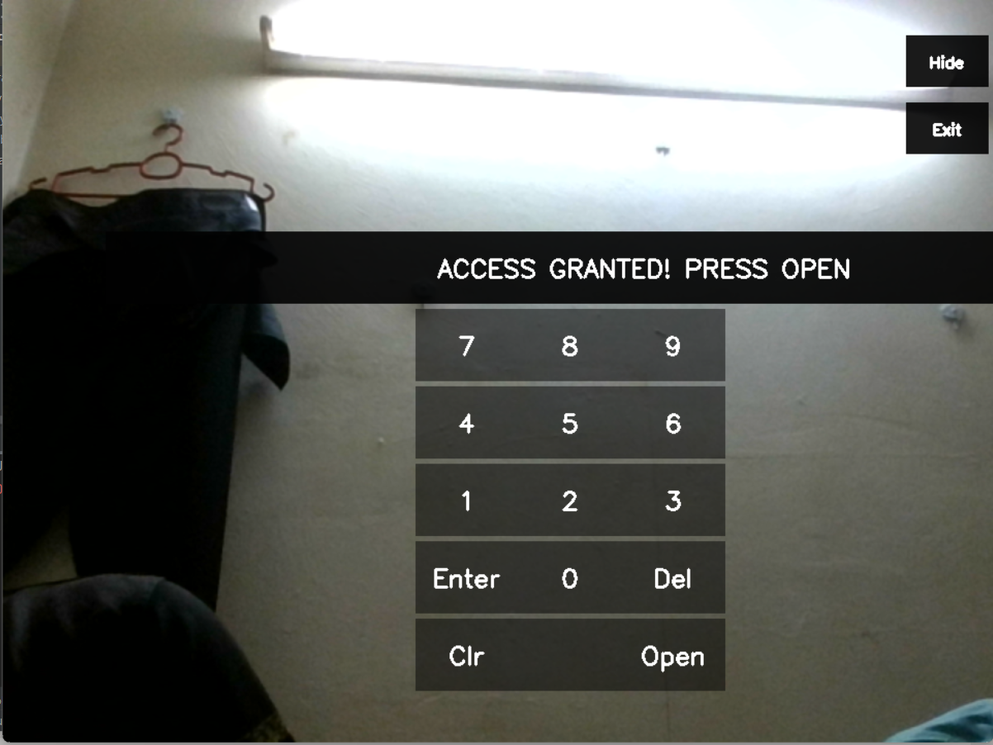
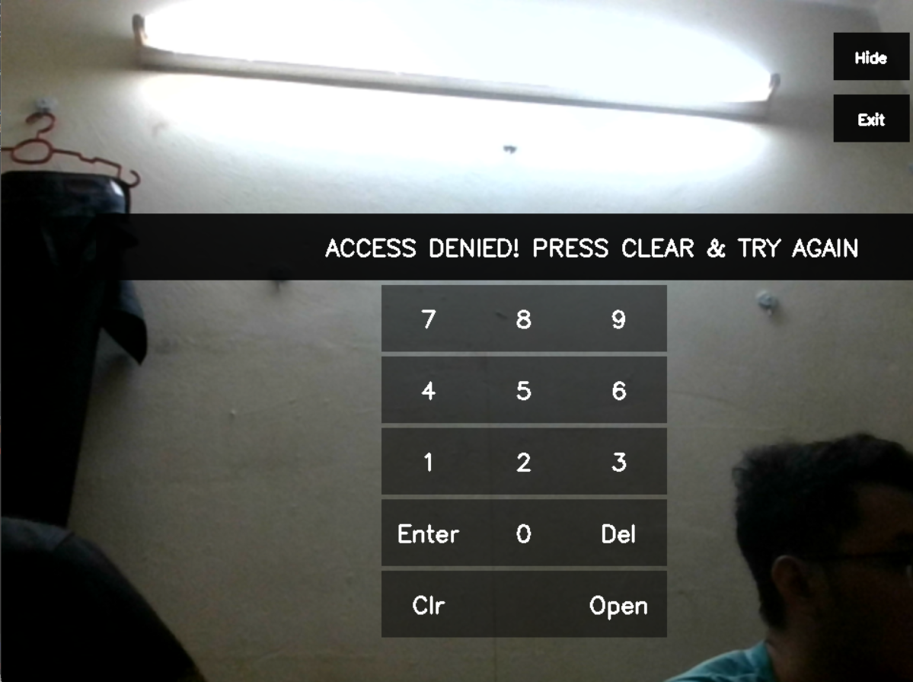
DOOR ACCES SYSTEM USING VIRTUAL NUMPAD
Muhamad Hidayat Mohammed Sohif ( 1817617 )
Muhammad Fareed Bin Mohd Noor (1810757)
Mohamad Anas Bin Mohamad Idris (1818965)
1. BACKGROUND
According to Utusan Malaysia, the Royal Malaysia Police (PDRM) has reported a total of 16,452 cases of home invasion from March 18th, 2019 to June 29th, 2021 during the MCO period. According to reports, during the Conditional Movement Control Order (PKPB) in stages, it has been observed that home invasions have slightly increased as conditions become more relaxed. It can be surmised that home invasions are more likely to occur when individuals are away from their homes for work. Till today, authorities such as home security providers and police have found it difficult to continuously monitor their neighborhoods and prevent incidents of home invasion. So, the introduction of our door access system will make it more challenging for intruders to enter homes and aid in reducing the incidence of home invasions.
2. PROCEDURE/METHODOLOGY
3. FLOW OF THE PROJECT
Overview :
System based on hand tracking
Password entered by clicking the virtual numpad
The distance of thumb(x,y) and index finger(x,y) is less than 50, the button is clicked
Access granted if the password is entered correctly and vice versa
Door opened
Figure: Flowchart of the system
Library used:
OpenCV – To have access to the camera to perform operations associated with computer vision.
NumPy – Make the image can be transform to array
MediaPipe - Analyzes an input image and, after cropping it to isolate just the hand, identifies 21 distinct landmarks on the hand portion.
Hand Tracker :
Import necessary library
Video capture using laptop camera
Convert image from BGR to RGB
Detect Hand and draw hand landmark
Get position of finger (thumb and index finger)
4. RESULTS
Hand Tracker:
5. CONCLUSION
Numpad:
Door access system using virtual numpad is achieved
Hand detection and tracking from the image is achieved
Have much clear user interface of the system.
Conditions:
6. FUTURE WORKS
The system is capable of capturing unfamiliar appearances and sending notifications to the user.
The system is able to directly communicate with authorities such as home security providers and police.
MACHINE VISION | MCTE 4323

